Slide 1
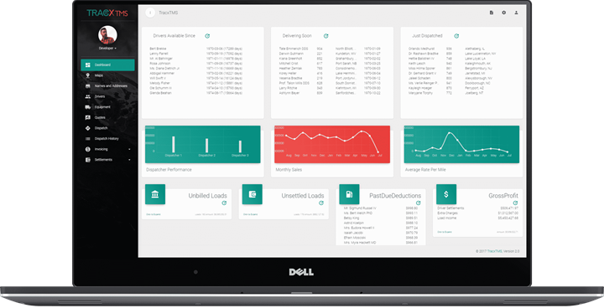
Features List
Your all-in-one Dispatch Software.
Revolutionary, Intuitive, Streamlined

Slide 2
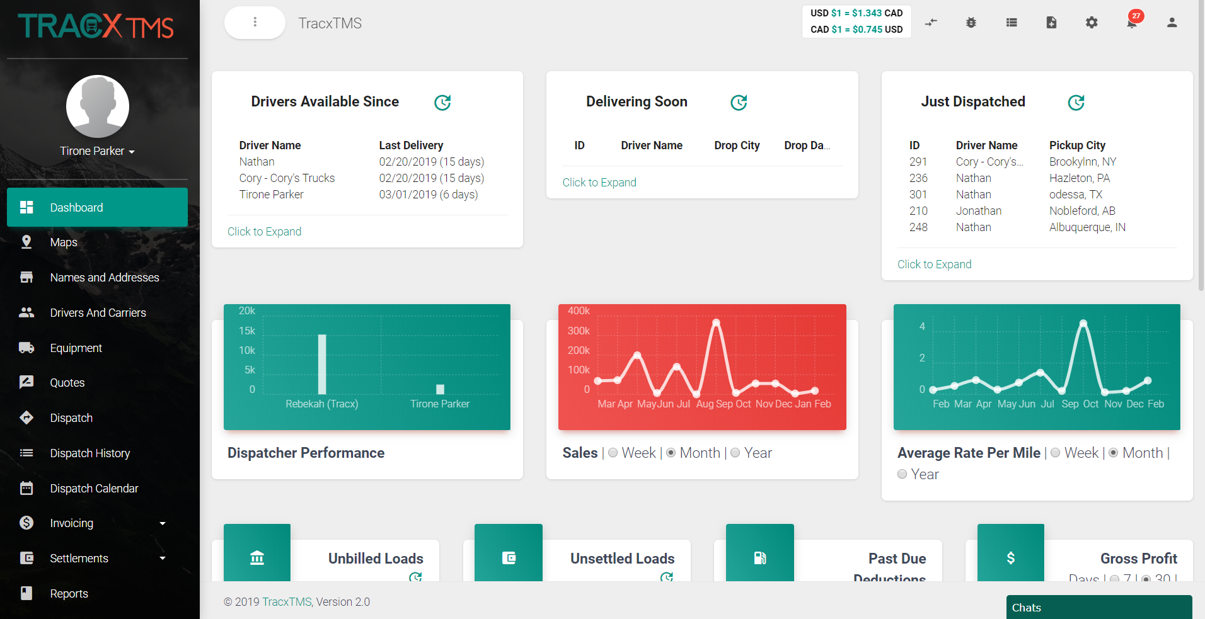
Dashboard
Easily add or remove any of the widgets you see on the dashboard.
Quick glance at driver availability, what’s delivering soon, and what has just been dispatched.
Track your dispatchers performance, sales and average rate per mile.
Quickly expand to see unbilled loads to your customers, unsettled loads to your drivers or carriers, past due deductions and your gross profits.
Easily see expiry dates for drivers such as: Licenses, Medical Cards, Permits, Passports, Insurance, etc.

Slide 3
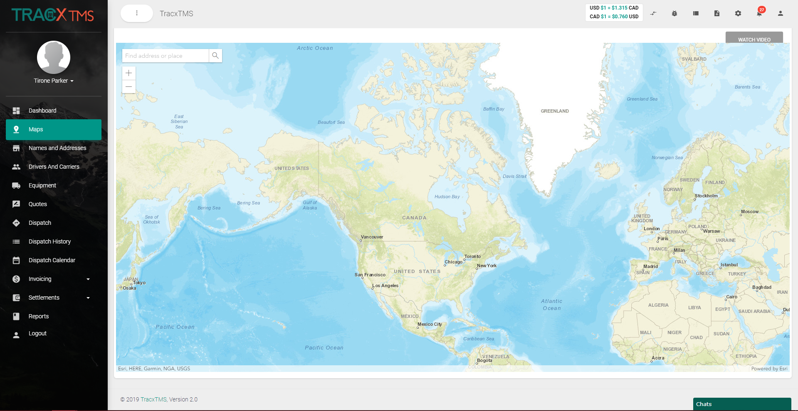
Maps
Easily integrate with any GPS provider to track driver information.
Our partnerships with Titan GPS also allows us to offer great incentives and top tier GPS services to our clients.

Slide 4
Customers
Import or manually add your customer list into TracxTMS
Add their billing information, addresses, contact information, and classify your customers to filter and organize them accordingly.
Easily edit and delete customer profiles with the action icons.
Upload documents and logos to your customer profiles with the action icons.
Create user accounts for your customers with the action icon and allow them to see their loads, information & documents.

Slide 5
Locations
Easily import your existing shippers and receivers, any where that your trucks will be picking up
New locations are easily added by typing the address in the routing of a load form and the system will search Google for you and save the location in the table to avoid any unnecessary data entry

Slide 6
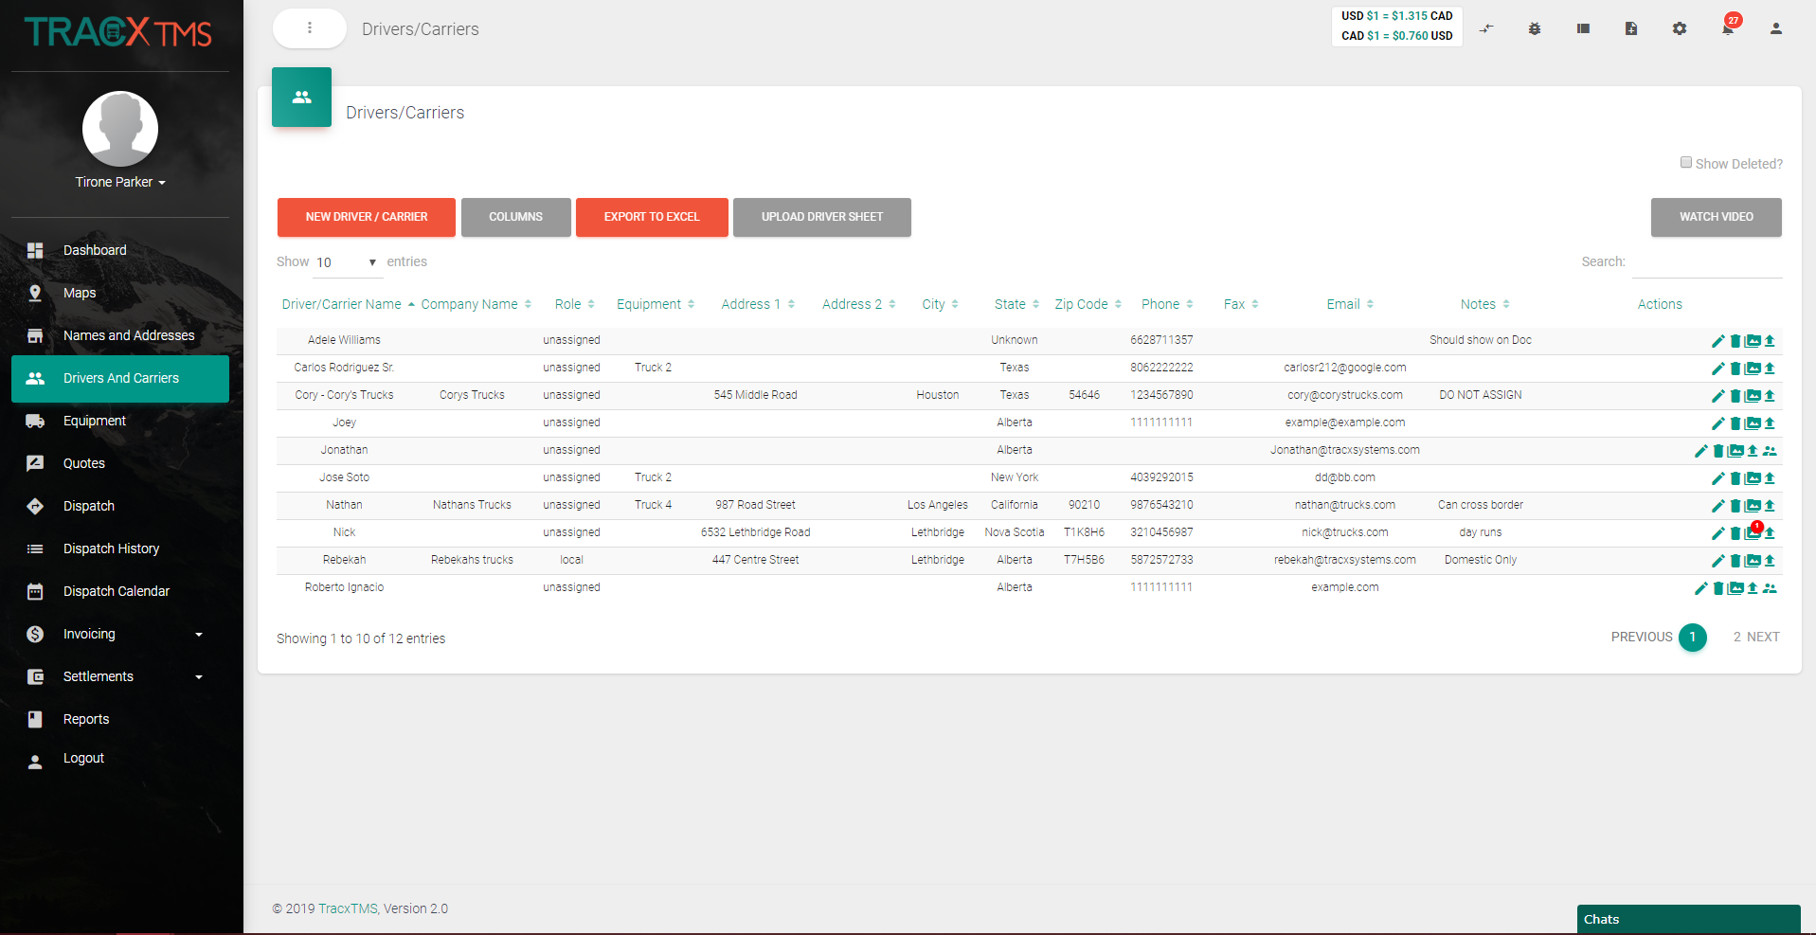
Drivers & Carriers
Simply enter driver or carrier information under “New Driver/Carrier” and add any custom data fields you like.
Add their general information, expiry dates, insurance information, assign them default equipment, and even a default payment type.
Easily edit and delete driver or carrier profiles with the action icons.
Upload any documents and add driver pictures with the action icons.
Create your drivers user accounts with the action icon, and allow them to access all their load information with our progressive web app (PWA) from their mobile devices.

Slide 7
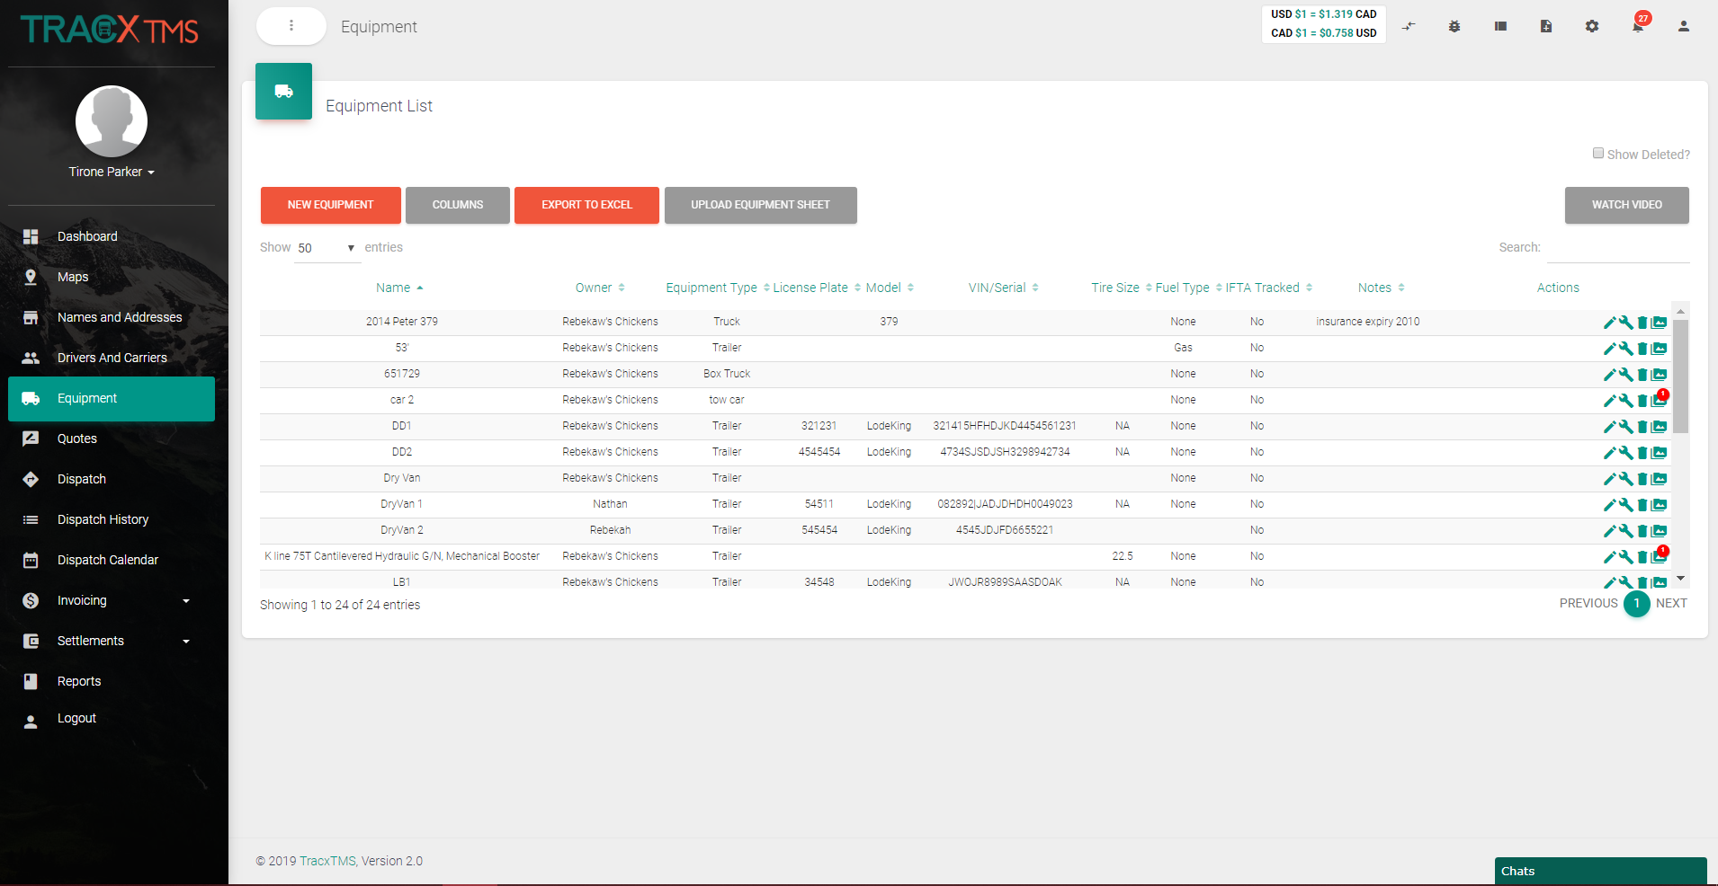
Equipment
Simply add your equipment under “New Equipment”, give it a name and type and add any custom data you like.
Add general information, equipment specs, even a GPS ID.
Easily edit or delete equipment profiles with the action icons.
Schedule and add maintenance records and reminders and upload any documents on your equipment with the action icons.

Slide 8
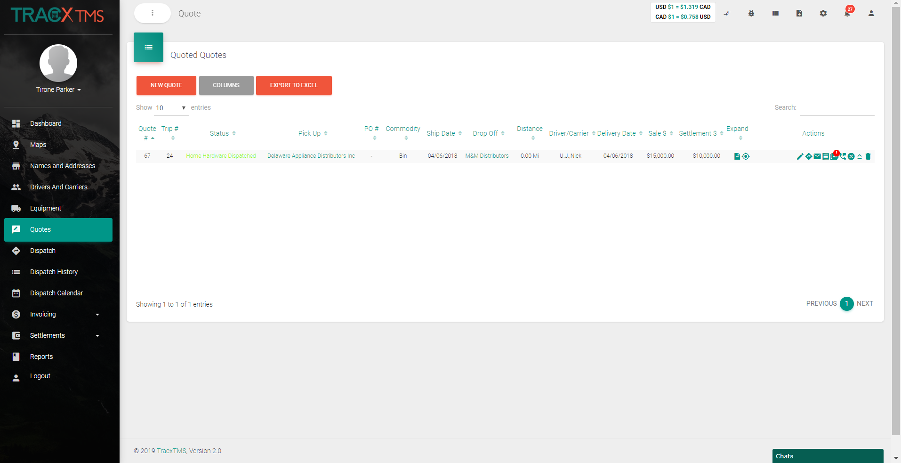
Quotes
Identical to the process of creating a new load, our quote system allows you to easily add in just the necessary information to create a rate confirmation to send to a client.
Once you have put in the details easily email the document to your client with the mail action icon.
Once the quote is signed and confirmed simply click the “Convert to Load” action icon to move the quote to an active load in your dispatch screen, reducing the time it takes to re-create the load again.
Easily edit and delete, or upload any documents to any quotes with the action icons.

Slide 9
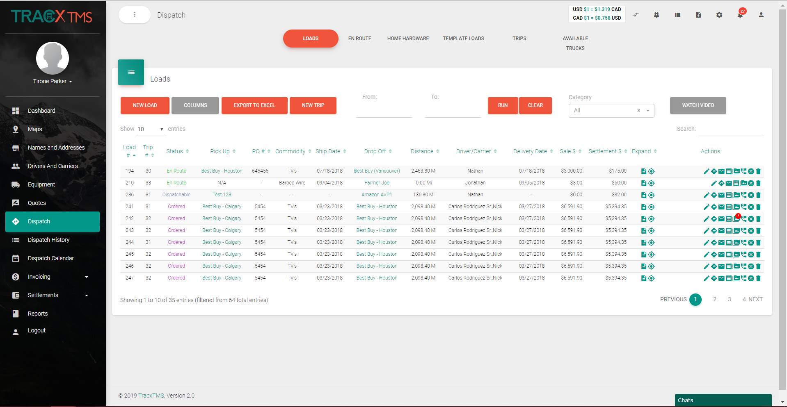
Dispatch
Simply create your loads under “New Load. Add in your billing information, customer information, rate types and much more.
Easily type in the # of times you want a load to repeat, saving you time. even create templates for later use.
Assign drivers or carriers, equipment and payment types.
Select your Pick/Drop/Empty locations, drivers and even add appointment times. Quickly calculate the mileage or kilometers.
Add notes, show maps, see margins and add any custom data to your loads.
Filter your loads by customizing and changing your load statuses (En Route, Delivered, Ordered). Quick filter even further with custom tabs.
Combine several loads into trips for LTL’s
Upload any documents, text or message your drivers, send emails and documents, even combine them into one PDF with the action icons.

Slide 10
Drop & Hook
Create “Leg Based” routing and planning
Easily assign multiple drivers or carriers to manage multi-step dispatches
See a daily view of your load categories to keep on top of what is happening today and never lose a load again

Slide 11
LTL
Easily add a second shipment to an existing load to consolidate freight to save money and streamline your customer shipments
Combine already existing loads into trips with simple routing for last minute planning
Share real time routing updates with drivers in their PWA

Slide 12
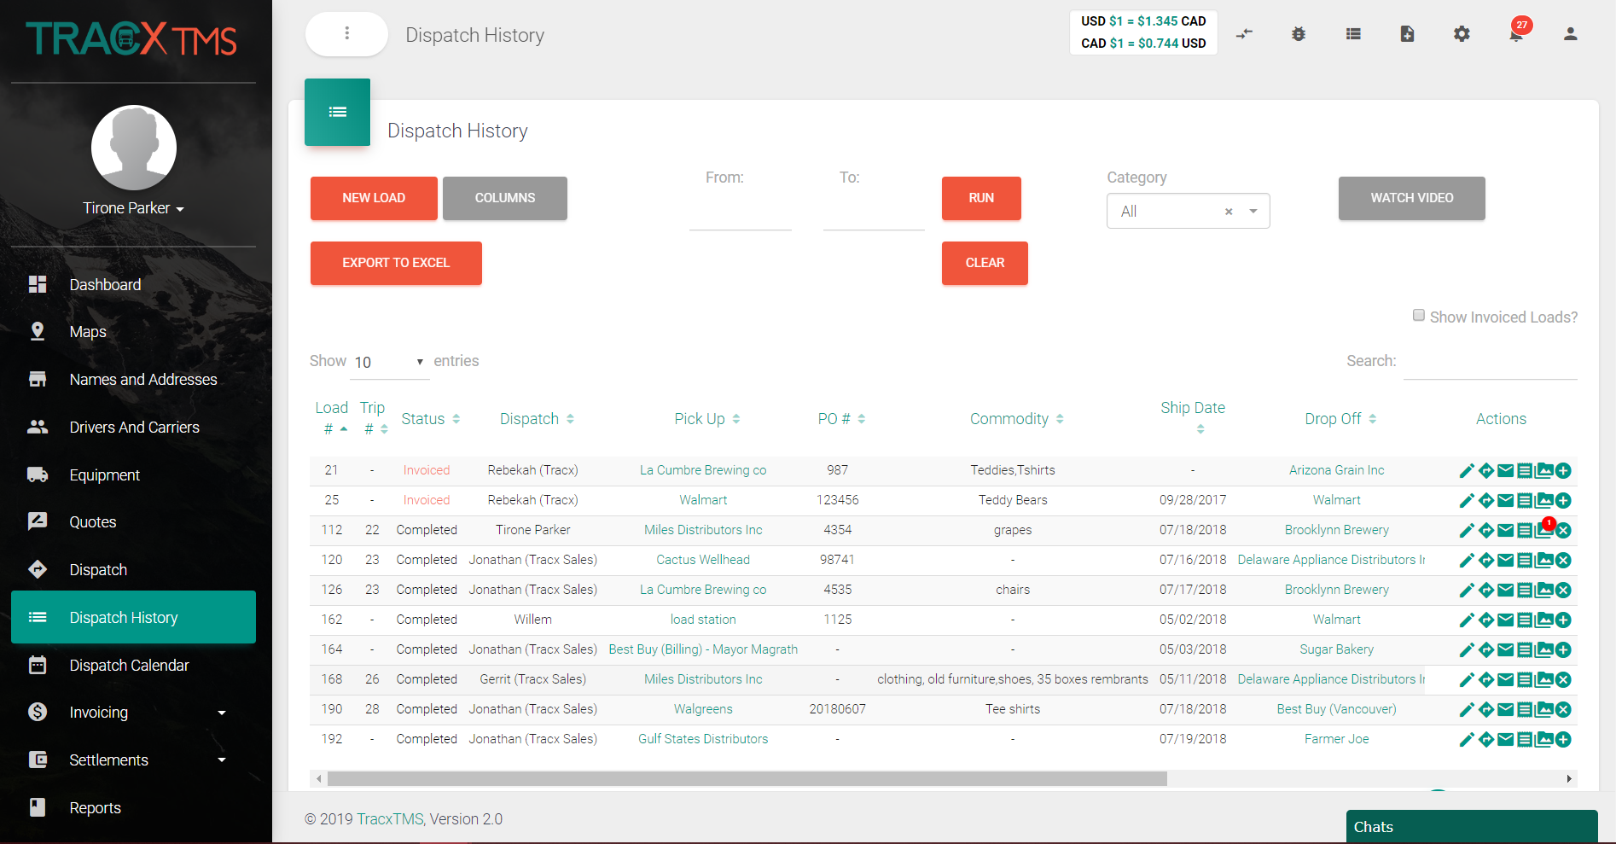
Dispatch History
Keep a complete forever history of your completed dispatches.
Easily organize your old dispatches with custom statuses, run date range searches or master search a load by name for simplicity.
Easily edit completed loads, email documents, attach documents or add them to a trip if you forgot using the action icons.

Slide 13
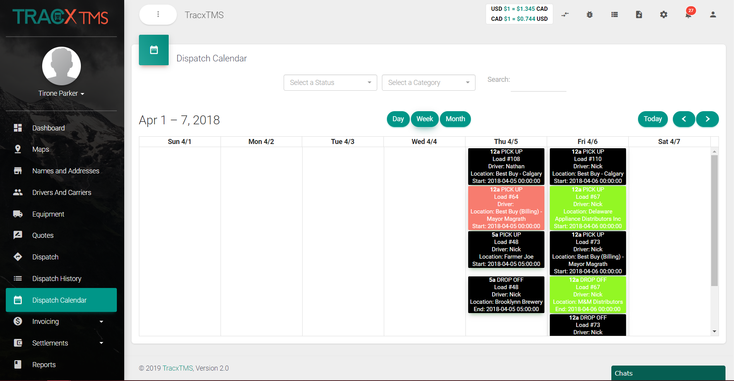
Dispatch Calendar
Give yourself a nice visual by day, week, or month of your loads.
Color coded according to the load statuses you set up.
Simply double click on a load to change its status, edit, or add any information, assign drivers, etc.
Filter to only see only the load statuses you desire.

Slide 14
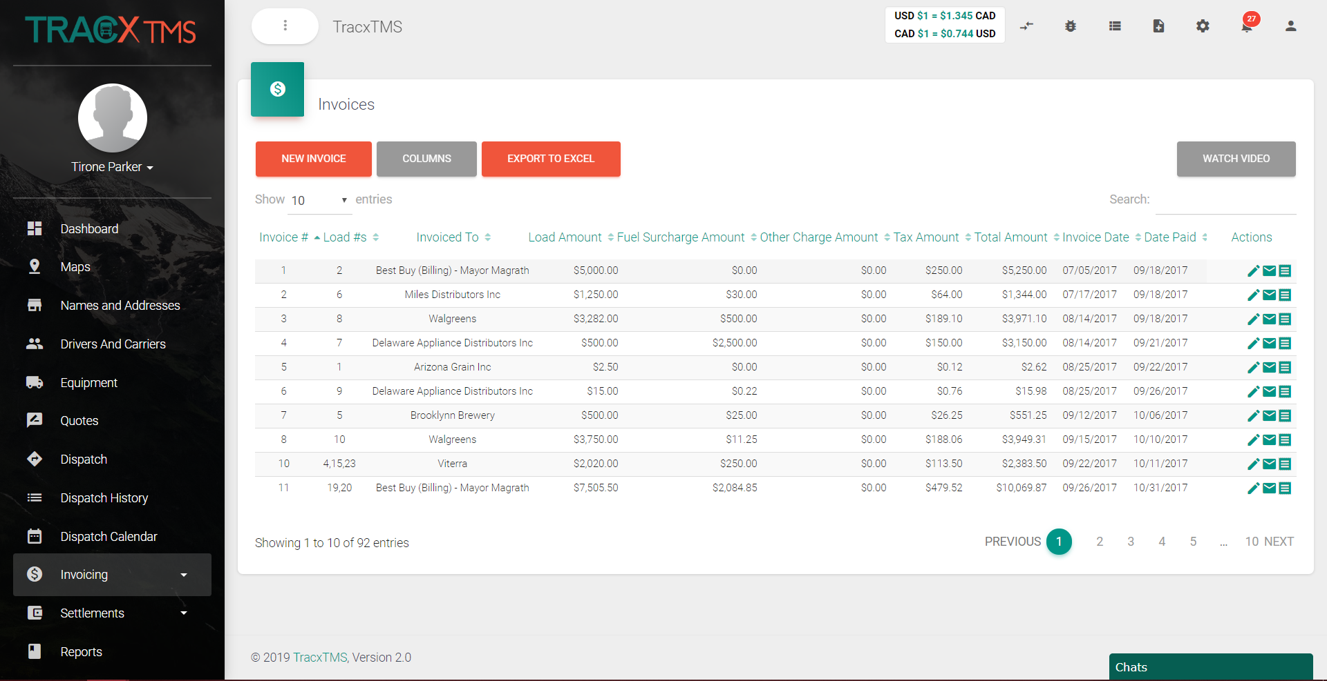
Invoices
Once a load has been completed simply create an invoice under “New Invoice” .
Choose the customer you want to invoice, batch all the loads or pick and choose which loads you want to invoice.
Email the clients invoice with the mail action icon, insert any other attachments you desire and merge all documents into a single PDF or keep them separate.
Easily send the invoice to your accounting software with the click of a button in the action icons.

Slide 15
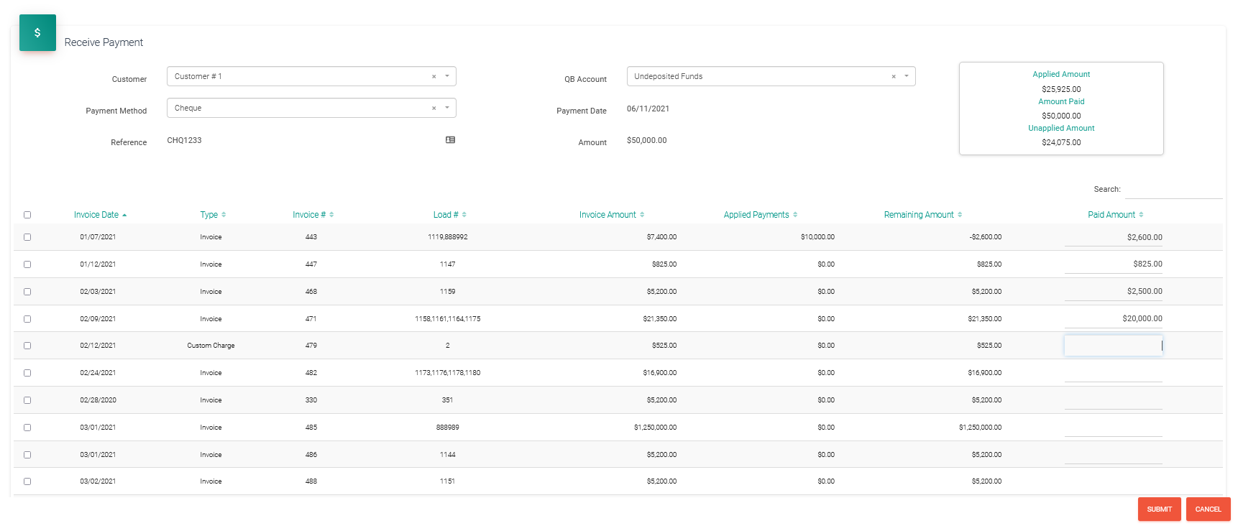
Receive Payments
Keep your accounts up to date with TracxTMS receive payments feature
Instantly receive payments against your invoiced loads and reconcile full and partial load payments
Robust accounts reporting to help you keep on top of your accounts

Slide 16
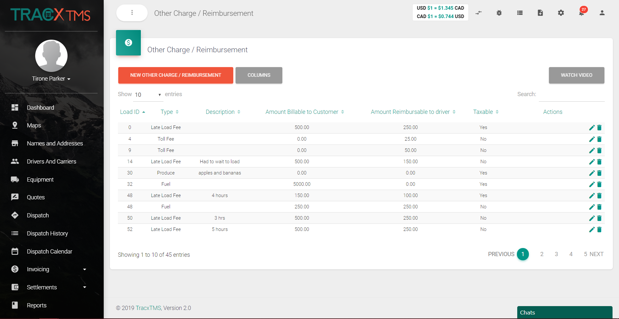
Other Charges & Reimbursements
Easily create custom charges or reimbursements.
Simply choose the load, add your custom charge type, and give it a description if you wish.
Type in the amount billable to your customer, amount reimbursable to your driver, choose if its taxable or not, click submit and let the software do the rest.
Easily edit and delete your charges and reimbursements with the action icons.

Slide 17
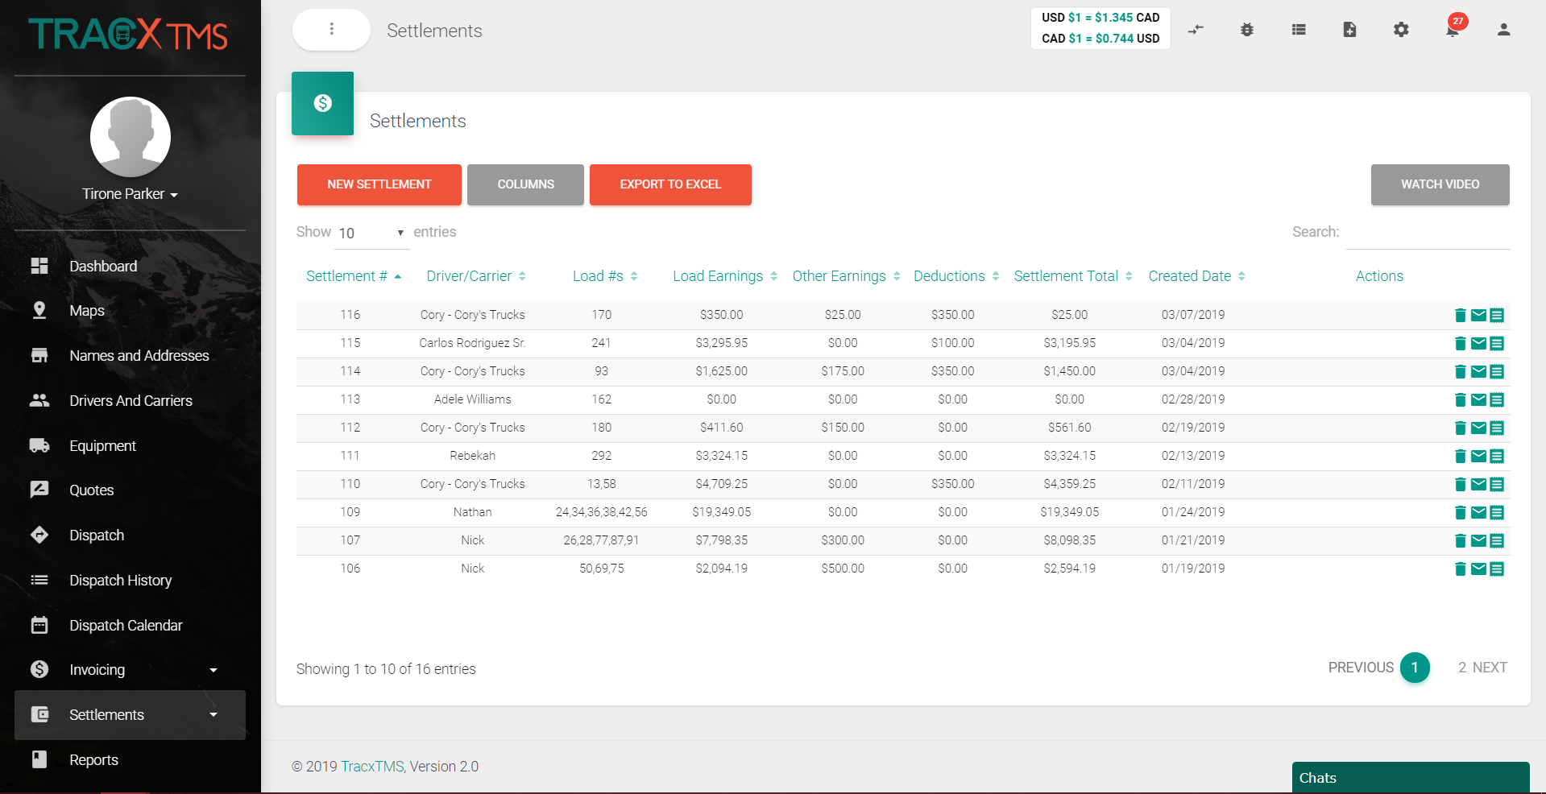
Settlements
Simply settle with your drivers or carriers under “New Settlement”.
Pick your driver or carrier, batch loads or pick and choose what loads you want to settle.
Select any deductions you have created or quickly create a new one.
Easily edit, delete, or send your settlements to your accounting software with the action icons.

Slide 18
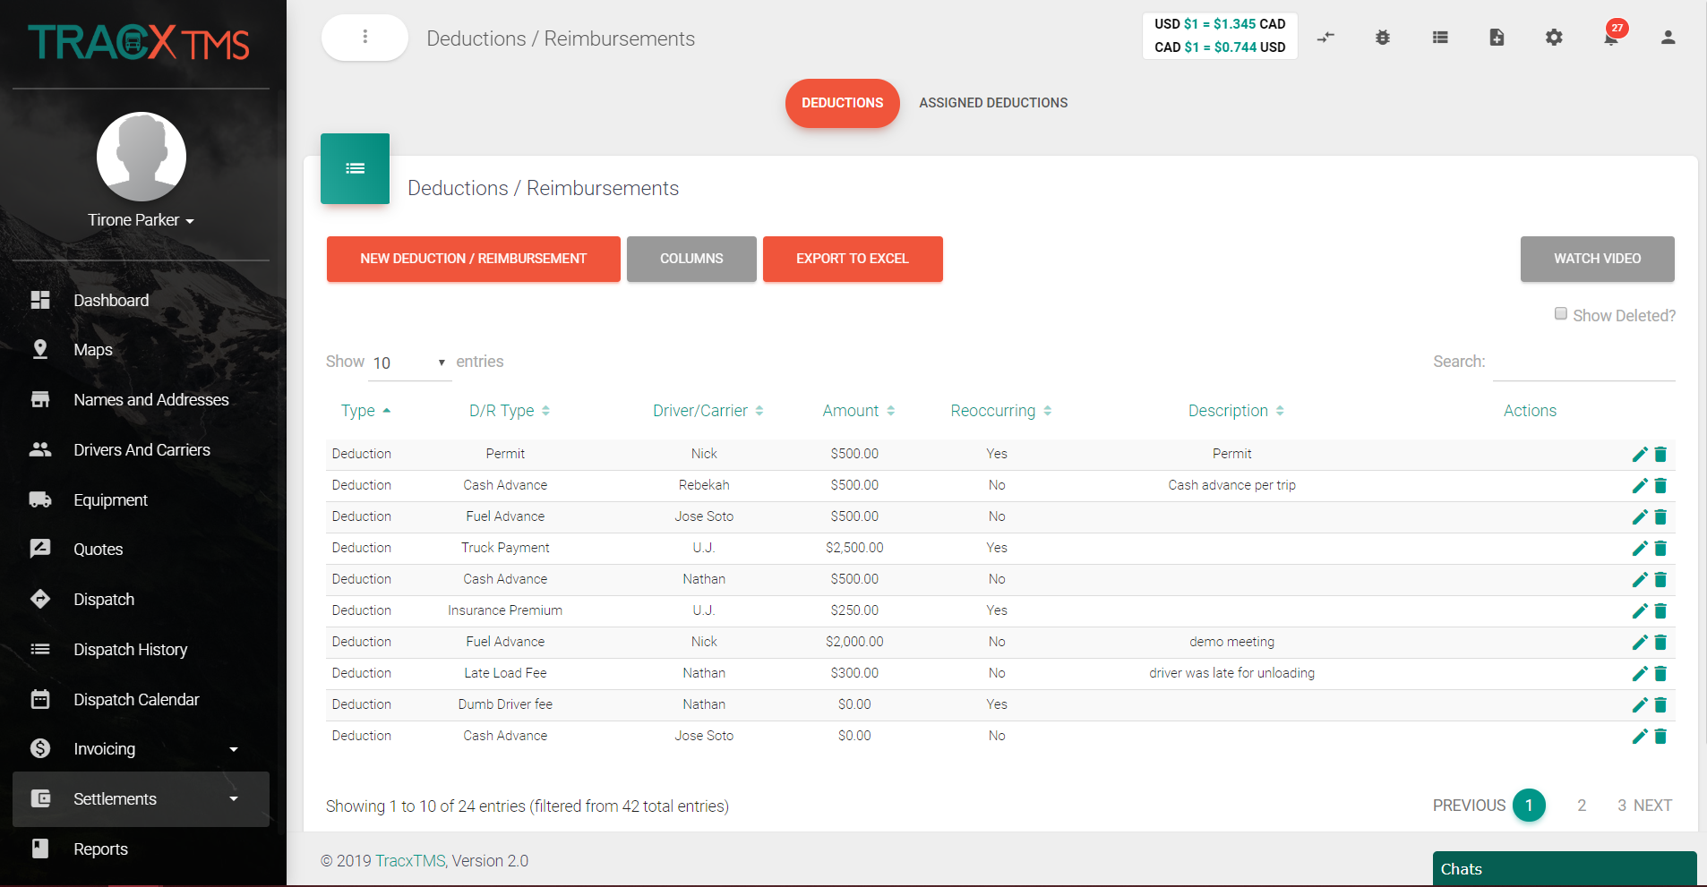
Deductions & Reimbursements
Much like “Other Charges & Reimbursements”, create any deductions or reimbursements for your drivers and carriers.
Choose whether or not deduction or reimbursement is reoccurring to save time in the future.
If you forgot to create the deduction type earlier you can create it on the fly without losing any progress.

Slide 19
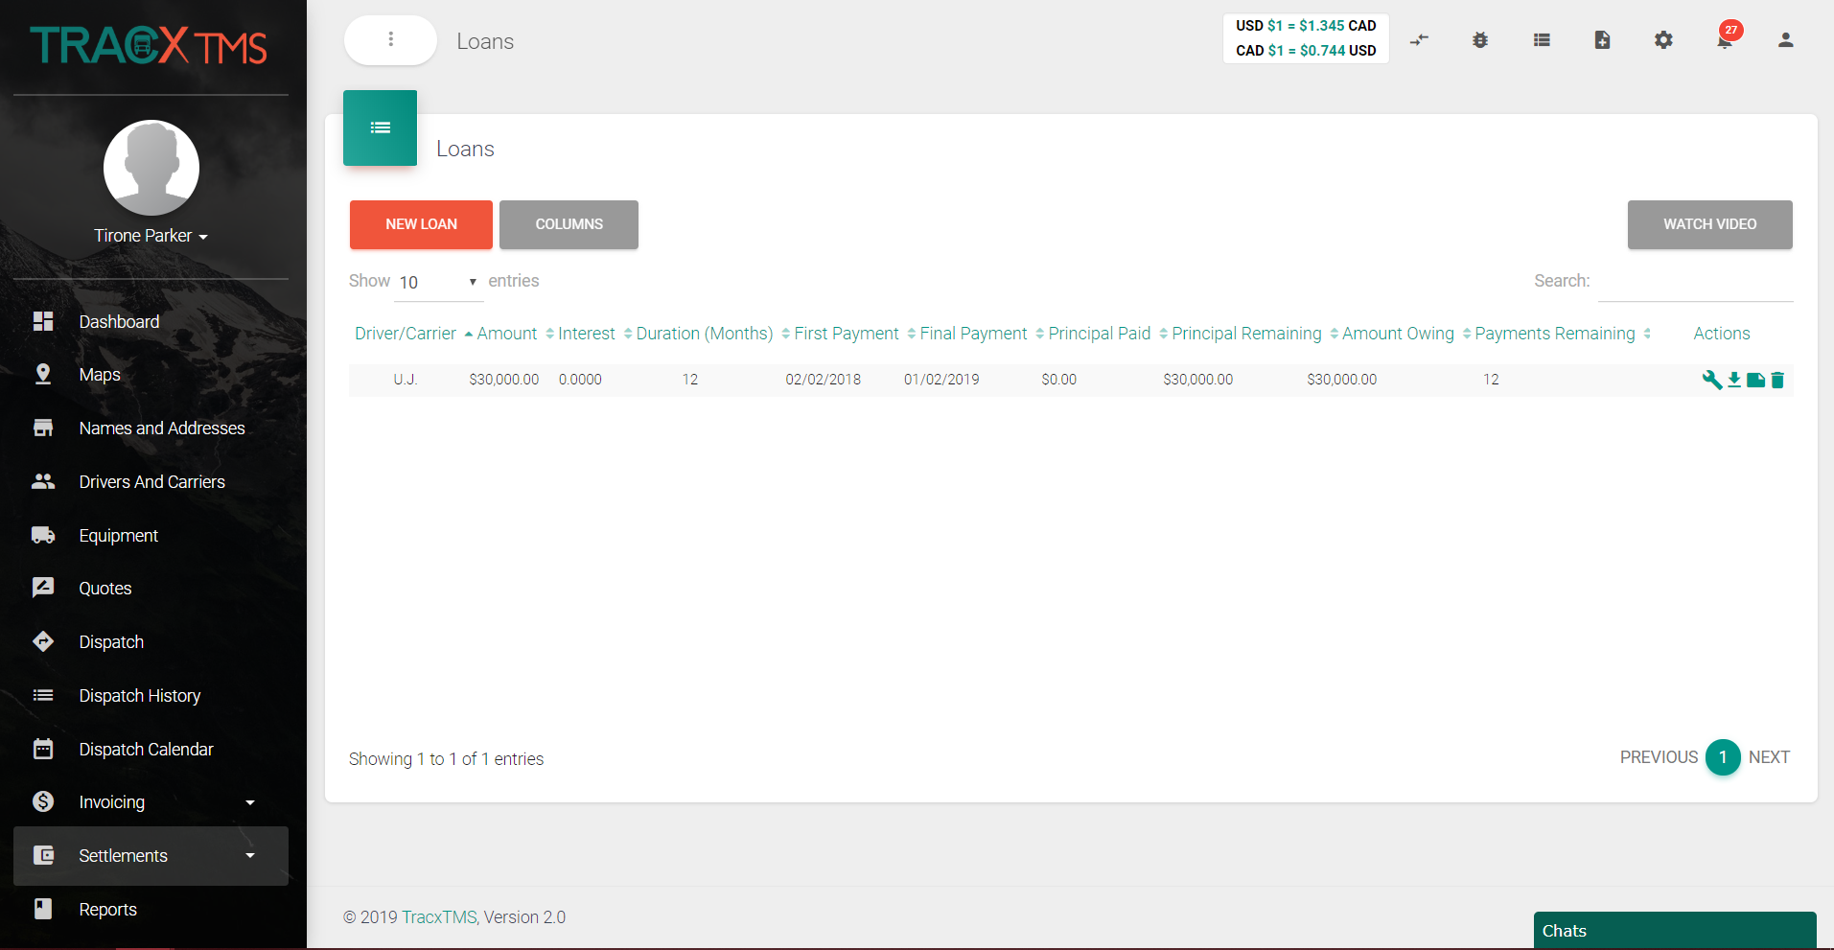
Loans
Create custom loans for your drivers or carriers.
Choose the driver or carrier, choose one of your custom deduction types.
Add in your first payment date, specify over how many months, put in the total loan amount and annual interest rate %.
Even add in payment frequency and compound frequency so that it automatically shows up as a deduction when you settle with your driver or carrier.
Easily alter payment dates, download the loan document, create notes or delete your loans using the action icons.

Slide 20
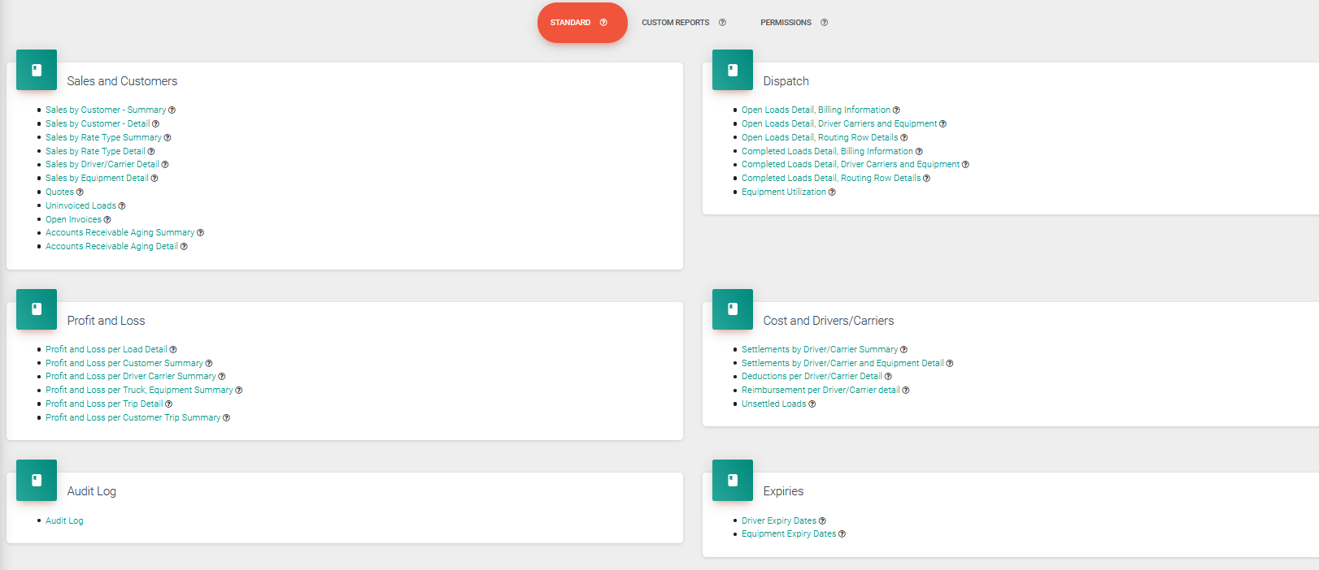
Reports
Ether choose from one of the standard reports provided by TracxTMS. Or allow us to build you any custom report you desire free of charge…After all, its your data.
Easily add permissions to your reports, and run reports via custom date ranges.

Slide 21
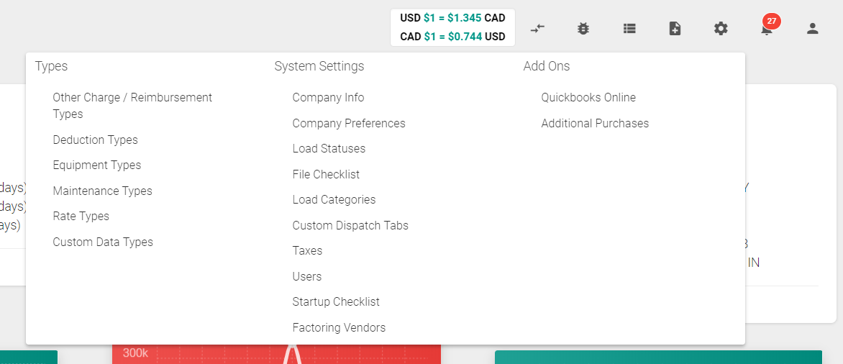
System Settings Menu
Customize the software to flow with your business model.
Create all your custom types, preferences, add tax codes, add factoring vendors, even create load categories for easy filtering.
Quickly and simply integrate to QuickBooks Online with the few easy clicks of a button.

Slide 22
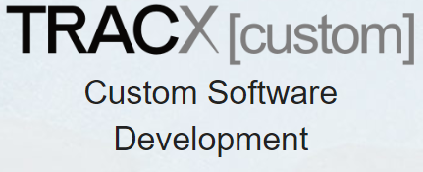
Customizations
Need custom features and integrations?
We have extensive experience developing software in many industries and a dedicated in house team of developers.
Affordable, fast ROI.
Accounting & truck scale integrations.
Ongoing support & maintenance.

